Slide 1
Chapter 2:EIGRP
1.It is an IGP protocol and known as a Hybrid protocol.
2.It is a Cisco proprietary protocol.
3.It uses Metric Bandwidth, delay, Reliability, load and MTU to select best path.
4.DUAL (Defusing Update algorithm) is used to calculate the metric.
5.It supports up to 100 hop count and can be extended up to 255.
6.It does load balancing up to four equal path and can do up to 16 unequal path by changing the variance command.
7.It supports class less routing.
8.It does auto summarization and also can do manual summarization.

Slide 2
EIGRP Protocol continued
9.It is a Protocol dependent module (Supports multiple protocols including IPv4, IPv6, Apple talk etc)
10.It supports MD5 authentication.
11.It supports communication via Reliable Transport Protocol (RTP)
12.It discovers neighbor automatically by sending hello in every 5 seconds, hold 15 seconds.
13.It uses Autonomus system (AS) to separate its routing table.
Let’s define some terms before we move on:
14.Feasiable Distance: The best metric among all paths to a remote network. The route with the lowest FD is the route that you will find in the routing table because it is considered the best path. The metric of FD is reported by Reported or Advertise Distance(AD).
15.Reported/advertised distance (AD): This is the metric of a remote network, as reported by a neighbor

Slide 3
EIGRP Protocol continued
16.Three tables used with EIGRP.
1.Routing Table
2.Neighbor Table
3.Topology Table
17. Feasible successor: A feasible successor is a path whose advertised distance is less than the feasible distance of the current successor.
EIGRP will keep up to 16 feasible successors in the topology table and one with the best metric will be copied to routing table.
18. Successor: A successor route is the best route to a remote network.
If a non successor route’s Rd is less than the FD, the route Is a feasible successor route.

Slide 4
EIGRP Protocol continued
Diffusing Update Algorithm (DUAL)-EIGRP uses Diffusing Update Algorithm (DUAL) for selecting and maintaining the best path to each remote network.
This algorithm allows for the following:
1.Backup route determination if one is available
2.Support of VLSMs
3.Dynamic route recoveries
4.Queries for an alternate route if no feasible successor route can be found
Using EIGRP to Support Large Networks:
Support for multiple ASs on a single router
Support for VLSM and summarization
Route discovery and maintenance

Slide 5
EIGRP Protocol continued
The formula for calculating EIGRP metric is:
Metric = 256*((K1*Bw) + (K2*Bw)/(256-Load) + (K3*Delay)*(K5/(Reliability + K4)))
k1=bandwidth
k2=load
k3=delay
k4=reliability
k5=MTU
the Metric would be
256 *( (k1 * BW) + (K3 * Delay))
Metric = 256 * ((10000000 / slowest bandwidth) + cumulative delay)/

Slide 6
EIGRP uses five basic protocol messages to do its work:
1.Hello-Neighbor ID, As number, Subnet information, K Values, Timers, Authentication,
2.Update-Contains following informations.
Prefix,
Prefix length,
Metric components (Bandwidth, delay, load, reliability),
Non metric items: MTU, Hop count
3.Query-
4.Reply,
5.Ack.
EIGRP uses two messages as part of the topology data exchange process: Update and Ack.
EIGRP Metric Tuning-EIGRP metrics can be changed using several methods: setting interface bandwidth, setting interface delay, changing the metric calculation formula by configuring k-values, and even by adding to the calculated metric using offset-lists.

Slide 7
Offset Lists-
An Offset List can perform the following functions:
Match prefixes/prefix lengths using an IP ACL, so that the offset is applied only to routes matched by the ACL with a permit clause.
Match the direction of the Update message, either sent (out) or received (in)
Match the interface on which the Update is sent or received.
Set the integer metric added to the calculation for both the FD and RD calculations for the route.
Command-
WAN1(config)#access-list 11 permit 10.11.1.0
WAN1(config)#router eigrp 1
WAN1(config-router)#offset-list 11 in 3 Serial0/0/0.1
Converging by Going Active:

Slide 8
Converging by Going Active
When EIGRP loses a route and there is no feasible successor the route will go from passive to active and the router starts sending queries to its neighbors.
EIGRP sends queries on all interfaces except the interface of the successor.
It can be resolved using either Summarization and Stub.

Slide 9
Chapter 5:OSPF Overview and neighbor relationship
OSPF Link State Concepts:OSPF uses link state (LS) logic, which can be broken into three major branches.
neighbor discovery:
topology database exchange: sometimes called its link state database (LSDB).
route computation:
Commonly Used OSPF Terms:
Link state database: The data structure held by an OSPF router for the purpose of storing topology data.
Shortest Path First (SPF): The analysis determines the best (lowest cost) route or each prefix/length.
Link State Update (LSU): The name of the OSPF packet that holds the detailed topology information, specifically LSAs
Link State Advertisemen: it is an OSPF data packet containing link-state and routing information that’s shared among OSPF routers. to advertise the routing update to neighbor routers
Area border Router (ABR):A router that has interfaces connected to at least two different OSPF areas, including the backbone area.

Slide 10
Continued
Designated router A DR is elected whenever OSPF routers are connected to the same multi-access network. Cisco likes to call these “broadcast” networks like Ethernet LAN.
Backup designated router- A BDR is a hot standby for the DR on multi-access links.
OSPF areas- An OSPF area is a grouping of contiguous networks and routers. All routers in the same area share a common Area ID.
Broadcast- (multi-access)- Broadcast networks such as Ethernet allow multiple devices to connect to the same network.
Non-broadcast multi-access-
networks are types such as Frame Relay, X.25, and Asynchronous Transfer Mode (ATM). These networks allow for multi-access but have no broadcast ability like Ethernet.
Point-to-point - consisting of a direct connection between two routers that provides a single communication path.
Point-to-multipoint – it refers to a type of network topology consisting of a series of connections between a single interface on one router and multiple destination routers.

Slide 11
OSPF Continued
1.It is an IGP protocol and known as a Link state protocol.
2.It is a open standard protocol.
3.It uses Metric as a cost to select best path.
4. It uses SPF algorithm and Dijkstra algorithm to calculate the metric.
5.It supports up to 255 hop count.
6.It does load balancing up to four equal path.
7.It supports class less routing, VLSM/CIDR
8.It does not auto summarization and supports manual summarization.
10.It supports Null0 , Type 1 clear text and Type 2 MD5 authentication .
11.It discovers neighbor automatically by sending hello in every 10 seconds at multicast address 224.0.0.5, hold 40 seconds.
12.It uses process id to separate its routing table.

Slide 12
OSPF Terminology
13.It breaks its big network into area.
14. It uses LSA Link State Advertisement, it is an OSPF data packet
containing link-state and routing information that’s shared among OSPF routers. to advertise the routing update to neighbor routers
15. Router ID- The Router ID (RID) is an IP address used to identify the router.
16.Cisco uses formula 10*8/Bandwidth, thus 100Mbps will have a cost 1 and 10Mbps cost 10, with bandwidth 64000 cost 1563
17. Three tables.
Routing table-
Neighbor table-Adjacency table
Topology table-Database table
18. It uses IP Protocol type 89 as a transport port number.

Slide 13
Hello Packet:
Hello Packet:
OSPF Router ID -unique
Stub area flag *
Plus the following interface-specific settings:
Hello interval*
Dead Interval*
Subnet mask*
List of neighbors reachable on the interface
Area ID*
Router priority
Designated Router (DR) IP address
Backup DR (BDR) IP address
Authentication digest*

Slide 14
OSPF Authentication
Three types of authentication:
1.Type 0: No authentication
2.Type 1: Plain text
3.Type 2: MD5
Authentication must be enabled, plus the authentication type must be selected, through one of two means:
Enabling per interface using the ip ospf authentication MD interface sub command
Enabling on all interfaces in an area.
Configuring the Authentication.
The authentication keys must be configured per interface.
Enabling Interface Subcommand: Configuration Key password
ip ospf authentication null : Type 0 ---------
ip ospf authentication : Type 1 ip ospf authentication-key key-value
ip ospf authentication message-digest: ip ospf message-digest-key key 1 MD5

Slide 15
OSPF Network Types
Int type DR/BDR Timers Discovery Subnet
Broadcast Yes 10 yes Yes
P-to-p No 10 Yes Yes
Loopback No - - No
NBMA Yes 30 No Yes
P-to-M-B No 30 Yes Yes
P-to-M-NB No 30 No Yes

Slide 16
OSPF LSA Types
LSA1: Router-Each router creates its own Type 1 LSA to represent itself for each area to which it connects, and it is advertised with in area.
LSA2: Network-One per transit network. Created by the DR on the subnet.
LSA3: Net Summary-Created by ABRs to represent subnets listed in one area’s type 1 and 2 LSAs when being advertised into another area.
LSA4:ASBR Summary-Like a type 3 LSA, except it advertises a host route used to reach an ASBR.
LSA5:AS External-Created by ASBRs for external routes injected into OSPF.
LSA6:Group Membership-Defined for MOSPF; not supported by Cisco IOS.
LSA7:NSSA External-Created by ASBRs inside an NSSA area, instead of a type 5 LSA.
LSA8:External Attributes-Not implemented in Cisco routers.
LSA9-11: These lsa has been used by mpls.

Slide 17
OSPF Message Types and Functions
1.Hello-Used to discover neighbors, supply information used to confirm two routers should be allowed to become neighbors, to bring a neighbor relationship to a 2-way state.
2. Database Description (DD)- Used to exchange brief versions of each LSA.
3. Link-State Request (LSR)- A packet that lists the LSIDs of LSAs the sender of the LSR would like the receiver of the LSR to supply during database exchange.
4. Link-State Update (LSU) -A packet that contains fully detailed LSAs, typically sent in response to an LSR message.
5. Link-State Acknowledgment (LSAck)-Sent to confirm receipt of an LSU message.

Slide 18
OSPF Neighbor State Reference
Down-No Hellos have been received from this neighbor for more than the dead interval.
Attempt- Used when the neighbor is defined with the neighbor command, after sending a Hello, but before receiving a Hello from that neighbor.
Init-A Hello has been received from the neighbor, but it did not have the local router’s ID in it or lists parameters that do not pass the neighbor verification checks. This is a permanent state when Hello parameters do not match.
2Way-A Hello has been received from the neighbor, it has the router’s RID in it, and all neighbor verification checks passed.
ExStart-Currently negotiating the DD sequence numbers and master/slave logic used for DD packets.
Exchange- Finished negotiating the DD process particulars, and currently exchanging DD packets.
Loading-All DD packets are exchanged, and the routers are currently sending LSR, LSU, and LSAck packets to exchange full LSAs.
Full-Neighbors are fully adjacent,

Slide 19
OSPF route summarization, filtering and default routing
IOS limits OSPF route filtering to the following:
1.Filtering Type 3 LSAs on ABRs. In this filtering ABR will filter either IN or OUT direction to area.
2.Filtering Type 5 LSAs on ASBRs
3.Filtering the routes OSPF would normally add to the IP routing table on a single router.
The mechanics of the distribute-list router subcommand has a few surprises, which are summarized in this list:
The command requires either an in or out direction. Only the indirection works for
filtering routes as described in this section.
The command must refer to either a numbered ACL, named ACL, prefix list, or route map. Regardless, routes matched with a permit action are allowed into the routing table, and routes matched with a deny action are filtered.
Optionally , The router compares these parameters to the route’s outgoing interface.

Slide 20
Route Summarization
OSPF allows summarization at both ABRs and ASBRs but not on other OSPF routers.
Manual Summarization at ABRs.
#area area-id range ip-address mask[cost cost]
Manual Summarization at ASBRs:
summary-address{{ip-address mask} | {prefix mask}} [not-advertise]
Default routes and Stub Areas.
Domain-wide Defaults Using the default-information originate Command:
With all default parameters, it injects a default route into OSPF, as an External Type 2 route, using a Type 5 LSA, with metric 1, but only if a default route exists in that router’s routing table.
With the always parameter, the default route is advertised even if there is no default route in the router’s routing table.
The metric keyword defines the metric listed for the default 1.
The metric-type key word defines whether the LSA is listed as external type 1 or external type 2
The decision of when to advertise, and when to withdraw, the default route is based on matching the referenced route-mapwith a permit action.

Slide 21
Introducing Stubby Area Types : Stub
Stub Area: ABRs in stub areas advertise a default route into the stub area. At the same time, the ABR chooses to not advertise external routes (5 LSAs) into the area, or even instead to not advertise inter area routes (in Type 3 LSAs) into the area.
all routers in the stub area can still route to the destinations (based on the default route), but the routers require less memory and processing.
The following list summarizes these features of stub areas.
ABRs create a default route, using a Type 3 LSA, listing subnet 0.0.0.0 and mask 0.0.0.0, and flood that into the stub area.
ABRs do not flood Type 5 LSAs into the stub area.
The default route has a metric of 1
Routers inside stub areas cannot redistribute external routes into the stubby area, because that would require a Type 5 LSA in the area.
All routers in the area must be configured to be stubby.

Slide 22
Totally Stubby
The following list summarizes these features of Totally stubby areas.
ABRs create a default route, using a Type 3 LSA, listing subnet 0.0.0.0 and mask 0.0.0.0, and flood that into the stub area.
ABRs do not flood Type 5 and Type 3 LSAs into the stub area.
The default route has a metric of 1
Routers inside stub areas cannot redistribute external routes into the stubby area, because that would require a Type 5 LSA in the area.
All routers in the area must be configured to be totally stubby.

Slide 23
The Not-So-Stubby Area (NSSA)
LSA5 is not allowed on Stub and totally stubby areas–a feature that originally caused some problems. The problem is based on the fact that stub areas by definition should never learn a Type 5 LSA, and OSPF injects external routes , into OSPF as Type 5 LSAs. These two facts together mean that a stubby area could not normally have an ASBR that was injecting external routes into the stub area.
The not-so-stubby area (NSSA) overcomes the restriction on external routes and it converts those routes in LSA 7 with in stub area , and then again ABR will change it back to LSA 5.
ABRs flood Type 3 LSA into the area.
It filters Type 5 LSA.

Slide 24
Virtual Links
OSPF area design requires the use of a backbone area, area 0, with each area connecting to area 0 through an ABR, in some cases two backbone areas exist.
Understanding OSPF Virtual Link Concepts:
An OSPF virtual link allows two ABRs that connect to the same non backbone area to form a neighbor relationship through that non backbone area, even when separated by many other routers and subnets.

Slide 25
Chapter: BGP
16-Bit ASN Assignment Categories from IANA
0 Reserved
1 through 64,495 Assignable by IANA for public use
64,496 through 64,511 Reserved for use in documentation
64,512 through 65,534 Private use
65,535 Reserved
Separate four cases of BGP.
1.Single Homed -The single-homed Internet design uses a single ISP, with a single link between the Enterprise and the ISP.
2. Dual Homed-The dual-homed design has two (or more) links to the Internet, but with all links connecting to a single ISP.
3. Single Multihomed-A single-multihomed topology means a single link per ISP, but multiple (at least 2) ISPs.
4. Dual Multihomed- With this design, two or more ISPs are used, with two or more connections to each.

Slide 26
Requirements for Forming eBGP Neighborship
A local router’s ASN must match the neighboring router’s reference to that ASN with its “neighbor remote-as asn” command.
The BGP router IDs of the two routers must not be the same.
If configured, MD5 authentication must pass.
Each router must be part of a TCP connection with the other router,
BGP Neighbor States-
Idle- The BGP process is either administratively down or awaiting the next retry attempt.
Connect- The BGP process is waiting for the TCP connection to be completed. You can not determine from this state information whether the TCP connection can complete.
Active- The TCP connection has been completed, but no BGP messages have been sent to the peer yet.
Opensent- The TCP connection exists, and a BGP Open message has been sent to the peer, but the matching Open message has not yet been received from the other router.
Openconfirm- An Open message has been both sent to and received from the other router and waiting for BGP Keepalive message (to confirm all neighbor related parameters matched) or BGP Notification message (to learn there is some mismatch in neighbor parameters).
Established- All neighbor parameters match, the neighbor relationship works, and the peers can now exchange Update messages.

Slide 27
BGP Message Types
Open- Used to establish a neighbor relationship and exchange basic parameters, including ASN and MD5 authentication values.
Keepalive-Sent on a periodic basis to maintain the neighbor relationship.
Update-Used to exchange PAs and the associated prefix/length (NLRI) that use those attributes.
Notification-Used to signal a BGP error; typically results in a reset to the neighbor relationship.
Commands:
show ip bgp 0.0.0.0 0.0.0.0-List possible default routes.
show ip bgpprefix [subnet-mask]- List possible routes, per prefix.
show ip bgp neighbors ip-address received-routes-List routes learned from one neighbor, before any inbound filtering is applied.

Slide 28
Commands:
show ip bgp neighbors ip-address routes -List routes learned from a specific neighbor that passed any inbound filters.
show ip bgp neighbors ip-address advertised-routes-Lists routes advertised to a neighbor after applying outbound filtering.
show ip bgp summary- List the number of prefixes learned per neighbor.
Injecting Routes into BGP for Advertisement to the ISPs.
1.BGP network command
2.Redistribution from an IGP

Slide 29
Design Goals for Inter domain Routing
Scalability
• The Internet has more than 140,000 routes and is still growing.
Secure routing information exchange
• Routers from another AS cannot be trusted.
• Tight filters are required; authentication is desirable.
Support for routing policies
• Routing between autonomous systems might not always follow the optimum path.

Slide 30
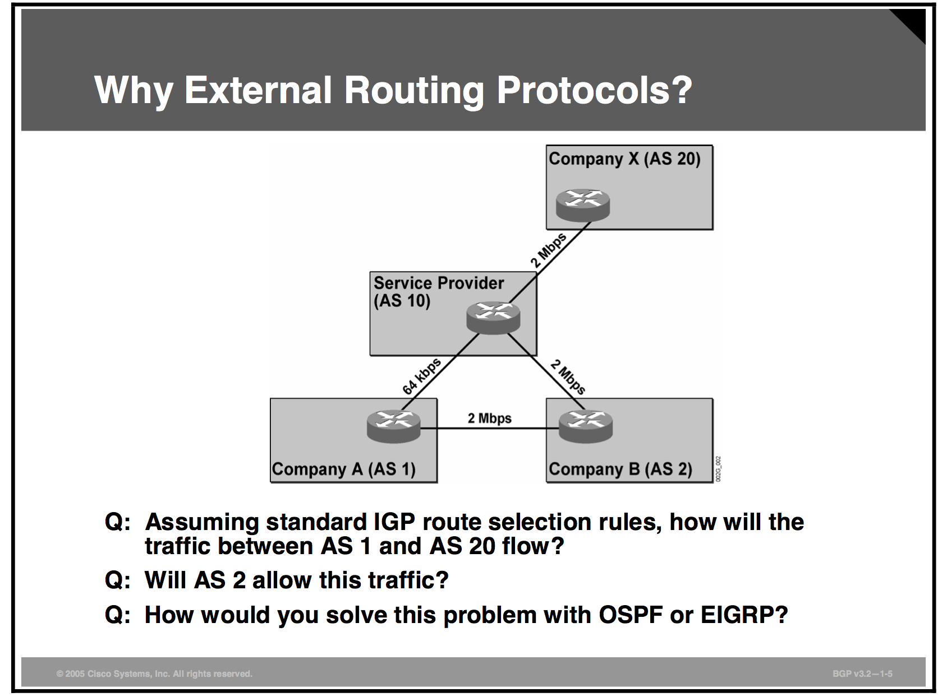
Why BGP

Slide 31
BGP Characteristics
BGP is a distance vector protocol with enhancements:
• Reliable updates
• Triggered updates only
• Rich metrics (called path attributes)
Designed to scale to huge internetworks
Reliable updates
• TCP used as transport protocol
• No periodic updates
• Periodic keepalives to verify TCP connectivity • Triggered updates batched and rate-limited
– Every 5 seconds for internal peer – Every 30 seconds for external peer
Protocol development considerations
• BGP was designed to perform well in the following areas:
– Inter domain routing applications
– Huge internetworks with large routing tables
– Environments that require complex routing policies
• Some design tradeoffs were made:

Slide 32
Characteristics Continued
BGP uses TCP for reliable transport—
CPU-intensive
Scalability is the top priority—slower convergence
Common BGP uses
Customers connected to more than one service provider
Service provider networks (transit autonomous systems)
Service providers exchanging traffic at an exchange point (CIX, GIX, NAP, ...)
Network cores of large-enterprise customers

Slide 33
BGP Limitations
BGP and associated tools cannot express all routing policies.
• You cannot influence the routing policies of downstream autonomous systems.
“BGP does not enable one AS to send traffic to a neighbor AS intending that the traffic take a different route from that taken by traffic originating in the neighbor AS.”

Slide 34
BGP Path Attributes
BGP metrics are called path attributes.
BGP attributes are categorized as “well-known” and
“optional.”
Well-known attributes must be recognized by all compliant implementations.
Optional attributes are recognized only by some implementations (could be private); expected not to be recognized by all.
Well-Known BGP Attributes :
Well-known attributes are divided into mandatory and discretionary.
Mandatory well-known attributes must be present in all update messages.
Discretionary well-known attributes are optional; they could be present in update messages.
All well-known attributes are propagated to other neighbors.
Mandatory Well-Known BGP Attributes

Slide 35
Mandatory WellKnown BGPA ttributes
• Origin
– The origin of a BGP route
• i RouteoriginatedinanIGP
• e RouteoriginatedinEGP
• ? RoutewasredistributedintoBGP
• AS-path
– Sequence of AS numbers through which the network is
accessible
• Next-hop
– IP address of the next-hop router
Discretionary Well-Known BGP Attributes
• Local preference
– Used for consistent routing policy within AS
• Atomic aggregate
– Informs the neighbor AS that the originating router aggregated routes

Slide 36
Optional BGP Attributes
Optional BGP attributes are transitive or nontransitive. • Transitive optional attributes
– Propagated to other neighbors if not recognized; partial bit set to indicate that the attribute was not recognized
• Nontransitive optional attributes – Discarded if not recognized
Recognized optional attributes are propagated to other neighbors based on their meaning (not constrained by transitive bit).
Nontransitive attributes • Multi-exit discriminator
– Used to discriminate between multiple entry points to a single AS
Transitive attributes • Aggregator
– Specifies IP address and AS number of the router that performed route aggregation
• Community
– Used for route tagging

Slide 37
AS-Path Attribute
The AS-path attribute is empty when a local route is inserted in the BGP table.
The AS number of the sender is prepended to the AS- path attribute when the routing update crosses AS boundary.
The receiver of BGP routing information can use the AS-path attribute to determine through which AS the information has passed.
An AS that receives routing information with its own AS number in the AS path silently ignores the information.

Slide 38
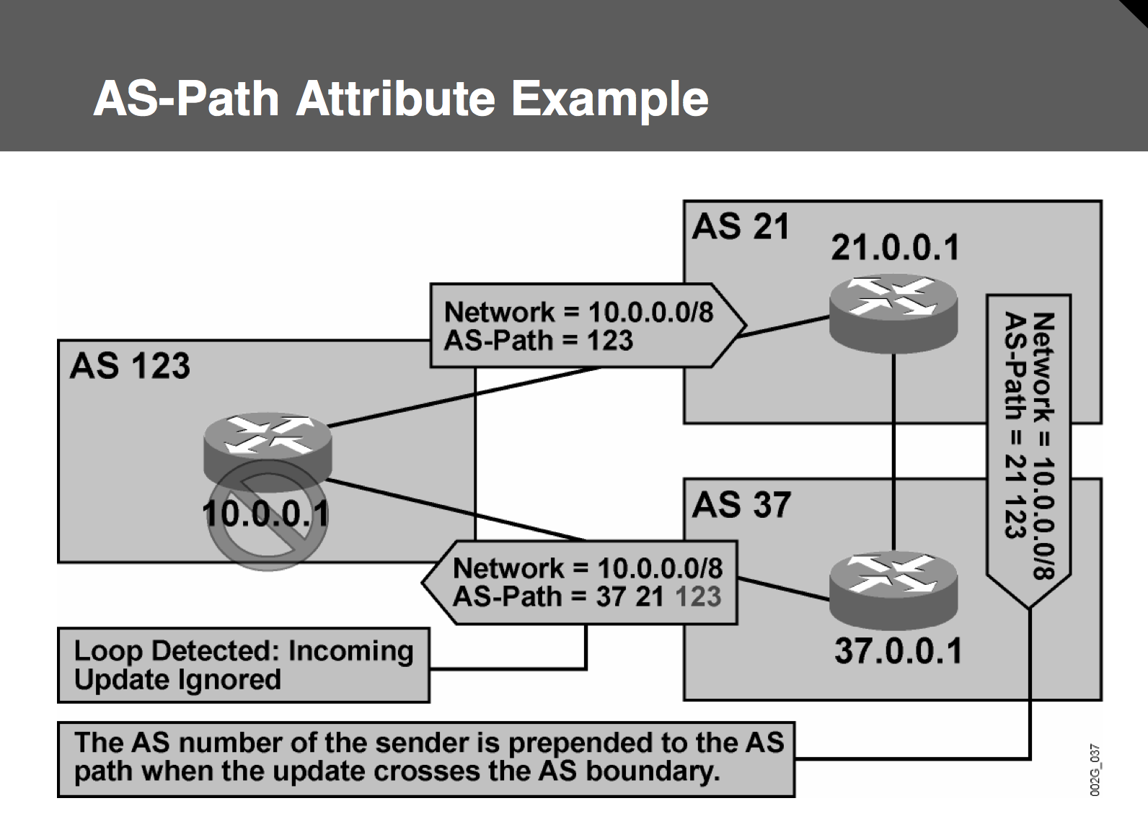
Example

Slide 39
Next-Hop Attribute
Indicates the next-hop IP address used for packet forwarding
Usually set to the IP address of the sending External Border Gateway Protocol (EBGP) router
Can be set to a third-party IP address to optimize routing

Slide 40
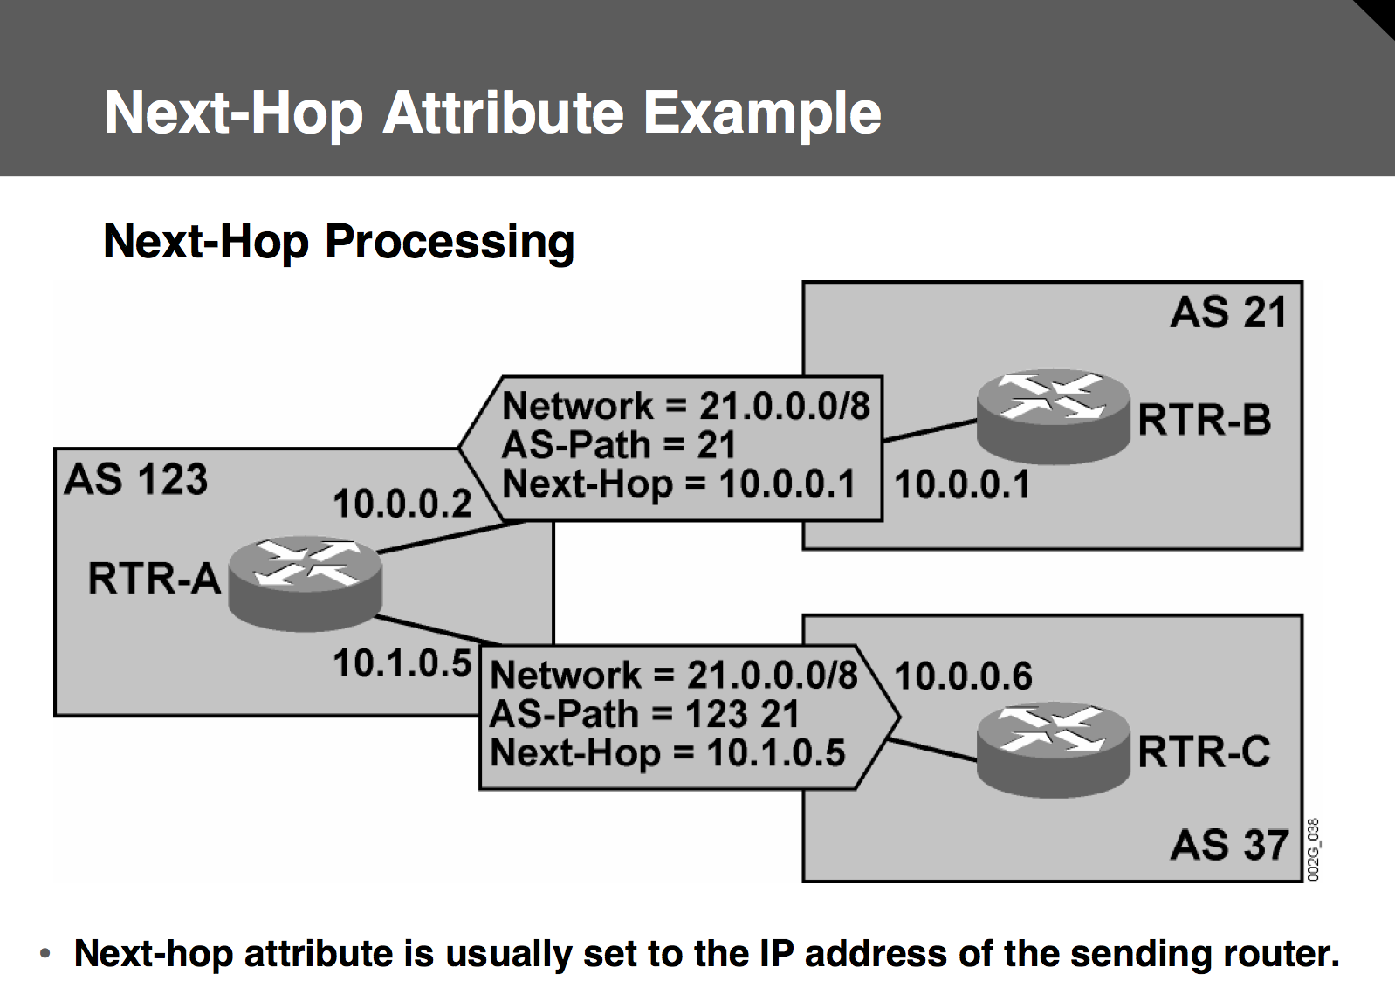
Example

Slide 41
BGP Neighbor Discovery
BGP neighbors are not discovered; they must be configured manually.
Configuration must be done on both sides of the connection.
Both routers will attempt to connect to the other with a TCP
session on port number 179.
Only the session with the higher router-ID remains after the connection attempt.
The source IP address of incoming connection attempts is verified against a list of configured neighbors.

Slide 42
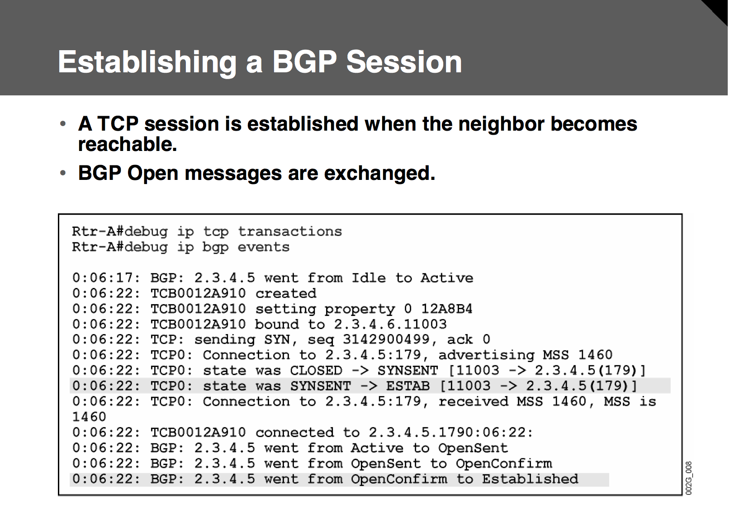
BGP Session

Slide 43
Establishing a BGP Session
The BGP Open message contains the following: • BGP version number
• AS number of the local router
• Holdtime
• BGP router identifier • Optional parameters
BGP Keepalives :
A TCP-based BGP session does not provide any means of verifying BGP neighbor presence:
– Except when sending BGP traffic
• BGP needs an additional mechanism:
– Keepalive BGP messages provide verification of neighbor existence.
– Keepalive messages are sent every 60 seconds.
Keepalive interval value is not communicated in the BGP Open message.
• Keepalive value is selected as follows:
– Configured value, if local holdtime is used
– Configured value, if holdtime of neighbor is used and keepalive < (holdtime / 3)
– Smaller integer in relation to (holdtime / 3), if holdtime of neighbor is used and keepalive > (holdtime / 3)

Slide 44
BGP Route Selection Criteria
• Exclude routes with inaccessible next hop
• Prefer highest weight (local to router)
• Prefer highest local preference (global within AS)
• Prefer routes that the router originated
• Prefer shortest AS path (only length is compared)
• Prefer lowest origin code (IGP < EGP < Incomplete)
• Prefer lowest MED
• Prefer external (EBGP) paths over internal (IBGP)
• For IBGP paths, prefer path through closest IGP neighbor • For EBGP paths, prefer oldest (most stable) path
• Prefer paths from router with the lowest BGP router-ID

Slide 45
Chapter16: IPV6
Advantages:
Address assignment features: Dynamic address assignment, including DHCP and Stateless Autoconfiguration.
Built-in support for address renumbering:
the ability to change the public IPv6 prefix current prefix with a short timeout and the new prefix with a longer lease life.
Built-in support for mobility: IPv6 supports mobility.
Provider independent and dependent public address space:
Aggregation:IPv6’s huge address space makes for much easier aggregation of blocks of addresses in the Internet.
No need for NAT/PAT:
IPsec:
Header improvements: routers do not need to recalculate a header checksum for every packet, reducing per-packet overhead.
No broadcasts:
Transition tools:

Slide 46
conventions
IPv6 conventions use 32 hexadecimal numbers, organized into 8 quartets of 4 hex digits separated by a colon, to represent a 128-bit IPv6 address, for example:
2340:1111:AAAA:0001:1234:5678:9ABC:1111
two conventions allow you to shorten an IPv6 address:
Omit the leading 0s in any given quartet.
Represent one or more consecutive quartets of all hex 0s with
classful and classless view of IPv4 addresses:
Network + Subnet + Host Classful ipv4 addressing
Prefix + Host Classless ipv4 addressing
IPv6 view of addressing and prefixes:
Prefix + Host IPv6 addressing

Slide 47
IPv6 Continued
Calculating the Interface ID Using EUI-64:
The EUI-64 process takes the 6-byte (48-bit) MAC address and expands it into a 64-bit value by inserts hex FFFE in between Like.
EUI-64 Format
1St half of MAC + FFFF + 2nd half of MAC
0034:5678:9ABC > 0034:56FF:FE78:9ABC
Flip the 7th bit of first byte > 0234:56FF:FE78:9ABC
Finding the DNS IP Addresses Using Stateless DHCP:
It supplies the DNS server IPv6 address(es) to clients.
Static IPv6 Address Configuration: Two options exist.
1.you configure the entire 128-bit IPv6 address,
2.you just configure the 64-bit prefix and tell the device to use an EUI-64.

Slide 48
Categories of addresses,
Unicast: Like IPv4, hosts and routers assign these IP addresses to a single interface to send and receive IP packets.
Multicast: Like IPv4, these addresses represent a dynamic group of hosts.
Anycast: This address type allows the implementation of a nearest server among duplicate servers concept.
Unicast IPv6 Addresses:
IPv6 supports three main types of unicast addresses: link local, global unicast, and unique local.
Unique Local/Site local IPv6 Addresses: Unique local unicast IPv6 addresses have the same function as IPv4 private addresses.
These addresses should be used inside a private organization, and should not be advertised into the Internet.
The address begins with FD (FD00::/8)
8 Bits 40 Bits 16 Bits 64 Bits
FD Global ID Subnet Interface ID

Slide 49
IPv6 Continued
Link Local Unicast Addresses: IPv6 uses link local addresses for sending and receiving IPv6 packets on a single subnet, It starts with FE80::/10 range the first 10 bits must be 1111 1110 10. the address always starts FE80, because the automatic process sets bits 11-64 to binary 0s.
10 Bits 54 Bits 64 Bits
FE80/10 All 0s Interface ID
Used as the source address for RS and RA messages for router discovery.
Used by Neighbor Discovery.
As the next-hop IPv6 address for IP routes.
Global Unicast IPv6 Addresses:
All addresses whose first 3 bits are equal to the first 3 bits of hex number 2000 (bits are 001). Which is considered as a public ipv6 address.

Slide 50
IPv6 Continued
Term Assignment Example
Registry prefix By IANA to an RIR 2340::/12
ISP prefix By an RIR to an ISP1 2340:1111/32
Site prefix By an ISP 2340:1111:AAAA/48
Subnet prefix For each individual 2340:1111:AAAA:0001/64
Method to assign the ipv6 address.
Stateful DHCP, Stateless autoconfig, Static configuration, Static config with EUI-64
Stateful DHCP for IPv6: IPv6 hosts can use stateful DHCP to learn and lease an IP address and corresponding prefix length (mask), and the DNS IP address(es), it is just like ipv4 DHCP, One difference between DHCPv4 and stateful DHCPv6 is that IPv4 hosts send IP broadcasts to find DHCP servers, whereas IPv6 hosts send IPv6 multicasts at FF02::1:2, other difference, IPv6 does not give any default router.

Slide 51
Stateless Autoconfiguration
Stateless autoconfiguration allows a host to automatically learn the key pieces of addressing information–prefix, host, and prefix length–plus the default router IP address and DNS IP addresses.
Step1:IPv6 Neighbor Discovery Protocol (NDP), particularly the router solicitation and router advertisement messages, to learn the prefix, prefix length, and default router.
Step2:Some math to derive the interface ID (host ID) portion of the IPv6 address, using a format called EUI-64
Step3:Stateless DHCP to learn the DNS IPv6 addresses
Learning the Prefix/Length and Default Router with NDP Router Advertisements:
ICMPv6 messages called , Router solicitation (RS) is sent by computer at FF02::2 to find out all connected routers for default gateway IP and all known IPv6 prefix on link .
Router will use Router Advertisement (RA) at FF02::1 to reply to all nodes.

Slide 52
Multicast IPv6 address
All IPv6 multicast addresses begin with FF::/8 in other words, with FF as the first two digits, But most of the multicast addresses referenced in this chapter, begin with FF02::/16.
All IPv6 nodes on the link FF02::1
All IPv6 routers on the link FF02::2
OSPF messages FF02::5, FF02::6
RIP-2 messages FF02::9
EIGRP messages FF02::A
DHCP relay agents FF02::1:2
DHCP servers (site scope) FF05::1:3
All NTP servers (site scope) FF05::101
Layer 2 Addressing Mapping and Duplicate Address Detection:
Neighbor Discovery Protocol for Layer 2 Mapping works just like IPv4 ARP, which is used to map mac from IP address.
Host send Neighbor solicitation (NS) to at FF02::2 asking MAC address of data link.
Router replies using Neighbor Advertisement (NA) and listing its MAC of data link.

Slide 53
Duplicate Address Detection (DAD)
The purpose of this check is to prevent hosts from creating problems by trying to use the same IPv6 address already used by some other host on the link.
Process: A host sends the NS message to the solicited node on its own IPv6 address. If some host sends a reply, listing the same IPv6 address as the source address, the original host has found that a duplicate address exists.
Inverse Neighbor Discovery:
On Frame Relay networks, and with some other WAN data link protocols, the order of discovery is reversed.
Router IOS IPv6 Configuration Command Reference:
1.ipv6 address address/length > Static configuration of the entire IPv6 unicast address.
2.ipv6 address prefix/lengtheui-64> Static configuration of the first 64 address bits; the router derives the last 64 bits with EUI-64.

Slide 54
Commands
3.ipv6 address autoconfig > Router uses stateless autoconfig to find address.
4. ipv6 address dhcp > Router uses stateful DHCP to find address.
5. ipv6 unnumbered interface-type number > Uses the same IPv6 unicast address as the referenced interface.
6. ipv6 enable > Enaaddressbles IPv6 on the interface, but results in only a link local.
7. ipv6 address address link-local > Overrides the automatically created link local address. The configured value must conform to the FE80::/10 prefix.
8. ipv6 address address/length anycast > Designates that the unicast address is an anycast.

